Slide 1
Leaders in financial recruitment

Slide 2
Who we are
Founded in 2010, 360 Search is a financial services recruitment consultancy led by, Lynda Barnes Partner and Sarah McGrath Partner. Their dedicated team of skilled consultants operates across the insurance, finance, life & pensions and compliance sectors.
In July 2018, we made the decision to partner with Recruitment Entrepreneur, founded and backed by James Caan CBE.

Slide 3
Our directors
Lynda Barnes Partner
Lynda has over 15 years’ market experience, having started her career as an insurance underwriter where she gained invaluable insights into the internal workings of the industry along with a technical understanding of equating risk.
During her career, Lynda has consulted, recruited and headhunted at the highest levels; playing a pivotal role in enabling international start-ups to map out and onboard the very best talent.
Sarah McGrath Partner
Sarah has over 10 years’ market experience and is a market leader with excellent negotiation skills. Sarah operates at senior and executive levels and is involved in discrete projects that require a confidential approach. She works with some of the most prolific entrepreneurs within the broker market and wider Financial Services.
Sarah holds a Degree in Business, Degree in Nutritional Therapy and is currently, mid-way through a Degree in Psychology.

Slide 4
Our board
Abid Hamid Chief Executive Officer
Abid trained as a lawyer before entering recruitment 25 years ago. He’s worked in over 35 countries and was director of a UK FTSE 250 company. As the founder of ARBP, a global recruitment training company, he has a wealth of experience in building and managing growing teams.
Angus McDowell Chief Financial Officer
Angus leads the finance team and advises on designing and developing a strategy to drive value creation. Angus has a wealth of managerial and board level experience and an MBA at Cass Business School
Greg Hollis Chief Operations Officer
With more than 20yrs recruitment and sales experience, Greg supports the creation and delivery of the company strategy, and growth plans. He also ensures best practice processes are implemented and used by everyone in the business.

Slide 5
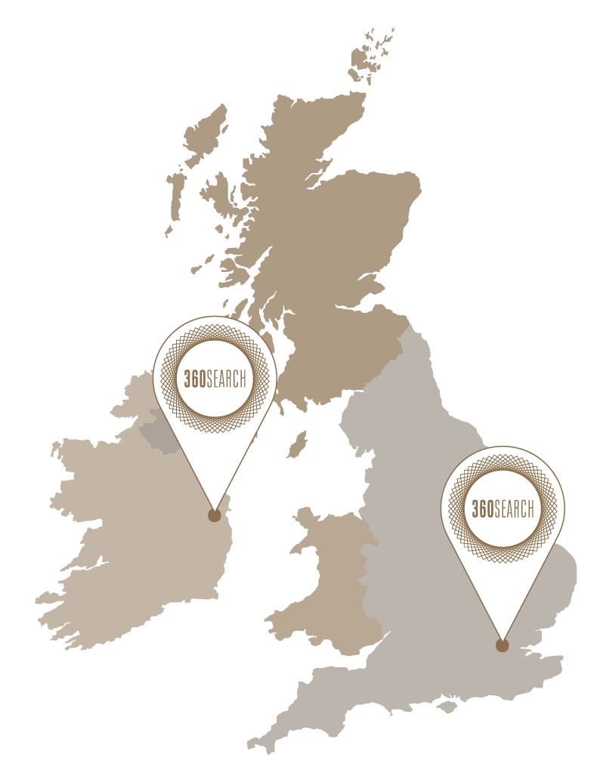
Our markets
Life & Pensions
Insurance
Compliance & Legal
Accountancy & Finance
Asset Management
Transformation & Change

Slide 6
Our philosophy
We are driven by the desire to excel in all aspects of the recruitment process. We pride ourselves on our ability to create valuable and long-lasting relationships and place great importance in operating ethically, and in the best interest of both our clients and candidates.
We are widely recognised for the exceptional quality of the candidates we represent. Our remit is to help employers find qualified professionals in permanent, temporary and contract positions across the financial services market, and introduce candidates to new careers that offer opportunity and reward, in equal measure.
We ensure that whether you are looking to recruit, or be recruited, you will always be placed in expert care with 360 Search. We understand that in niche markets privacy and discretion are paramount, and ensure this is reflected in every aspect of our processes.

Slide 7
Client services
Permanent recruitment
Advertised selection
Contract solutions
Executive search
Onsite services
Read more about our services here

Slide 8
What our clients say
I have dealt with Lynda at 360 Search on a number of occasions and she always exceeds my expectations. Her passion for what she does for her clients is evident every time we work together. She is full of energy and takes everything in her stride. She is clearly a leader in her field and I would strongly recommend working with her.
Jeremy Tucker MD and Founder of Tailored Finance Ltd, Health, Dental & Life Insurance Consultants
In my experience Sarah is at the top of her profession – she has a ‘can do’ attitude, is proactive at all times and has the skills and contacts to match the right people with the right employer. I would have no hesitation in recommending her as a first choice recruitment consultant who delivers on her promises.
Mark Johnston Insurance Development and Relationship Management at the Irish League of Credit Unions

Slide 9
What our clients say
When I think of recruitment, I automatically think of 360 Search. They are top-class professionals specializing in the insurance industry. They are great listeners and fully understand my requirements before recommending a new staff member. When it comes to insurance I always use and recommend Lynda and her team.
Noel Sweetman MD Kidd Insurances
Sarah is a great resource for any broker to have access to. She has great connections in the industry and always has access to a suitable candidate when you need one.
Graham Weir Managing Director of Pembroke Insurance

Slide 10
Candidate services
We connect you with the right people, in the right companies, for the right opportunities.
We take the time to listen to your aspirations and get to the heart of what makes you tick. We make introductions that are productive, worthy of your time and in-line with your career vision. We manage the whole process, from the initial introduction to the completion of your probation.
We only work with your permission and if the time isn’t right for you, it’s not right for us either.
Meeting We conduct one-on-one meetings, keeping an open dialogue throughout the process.
Feedback Everyone deserves feedback; we debrief the company and you after each interview.
Contact
We create relationships which outlive your placement to provide you with long-term support.
Read more about our process here

Slide 11
What our candidates say
I cannot recommend Sarah highly enough. On the 16th of May, I contacted her looking for assistance in my next career move. After meeting her for the first time the next day, she went on to secure me to offer I was looking for in my ideal role by the 28th May. I found the whole experience fast, efficient and very thorough. Sarah is lovely to deal with and I am very grateful for her assistance. I would have no hesitation in using Sarah’s skills again and recommending her to friends and colleagues.
Kevin Dillon Investment Support Specialist at Irish Life Investment Managers
I have known Lynda for several years, by reputation and through industry connections. Lynda is a consummate professional with a comprehensive understanding of the insurance industry. She matches her skillset with a friendly and engaging personality, balancing a candidate’s expectations with the needs of potential employers. I highly recommend 360 Search, Lynda and her team.
Maire Ryan McSherry

Slide 12
What our candidates say
I worked with Lynda at 360 Search on my latest career move and must say I was extremely impressed with her approach. She is extremely diligent and is dedicated to placing you in a position that matches your background. Unlike many recruiters, she thinks long term, so that both the candidate and the employer will stay the course.
Within 24 hours of my meeting with Lynda she was back to me with a perfect match. One month later, after excellent guidance through the interview process, I was offered that job and now look forward to starting. There’s a reason she is #1 on LinkedIn recruiter rankings!
Geoff Langan Broken Consultant at Applied Systems Ireland
I wholeheartedly recommend Sarah McGrath from my own very positive and productive experience of working with her. There are few if any people more knowledgeable about insurance recruitment in Ireland. Sarah is a true expert in her field.
Cathie Shannon – Director of General Insurance at Brokers Ireland

Slide 13
Our partnerships
James Caan CBE & Recruitment Entrepreneur
In July 2018, we took the decision to partner with the world's fastest growing recruitment investment specialist, Recruitment Entrepreneur, founded and backed by James Caan CBE.
Our strategy in joining the Recruitment Entrepreneur portfolio reflects our commitment to providing a consistently exceptional service to both candidates and clients. Our vision to expand to London and beyond is key in supporting our growing international client base.

Slide 14
Sponsorship
Brokers Ireland 360 Search has worked with Brokers Ireland for over a decade, supporting them by providing members with broking talent. We are delighted to be a part of Brokers Ireland and closely involved with their ongoing support of the Irish intermediary market. Find out more.
Connect Women in Pensions CWIP is a not-for-profit group for those supporting opportunities for women in pensions, as well as encouraging pension saving among women.
The organisation provides a platform for women to invest in their personal and professional growth by implementing best business practices. We help them raise awareness of the need for women to have sufficient pension provision.
Find out more.

Slide 15
31-32 Leeson Street Lower, Dublin 2
info@360search.ie | +353 1 63 44990 | 360search.ie

